Slide 1
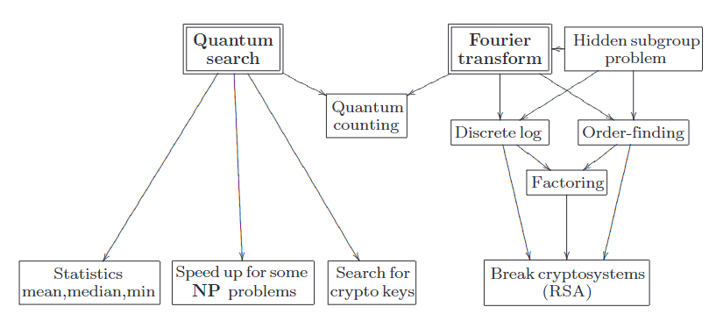
4.1. Quantum circuit

Slide 2
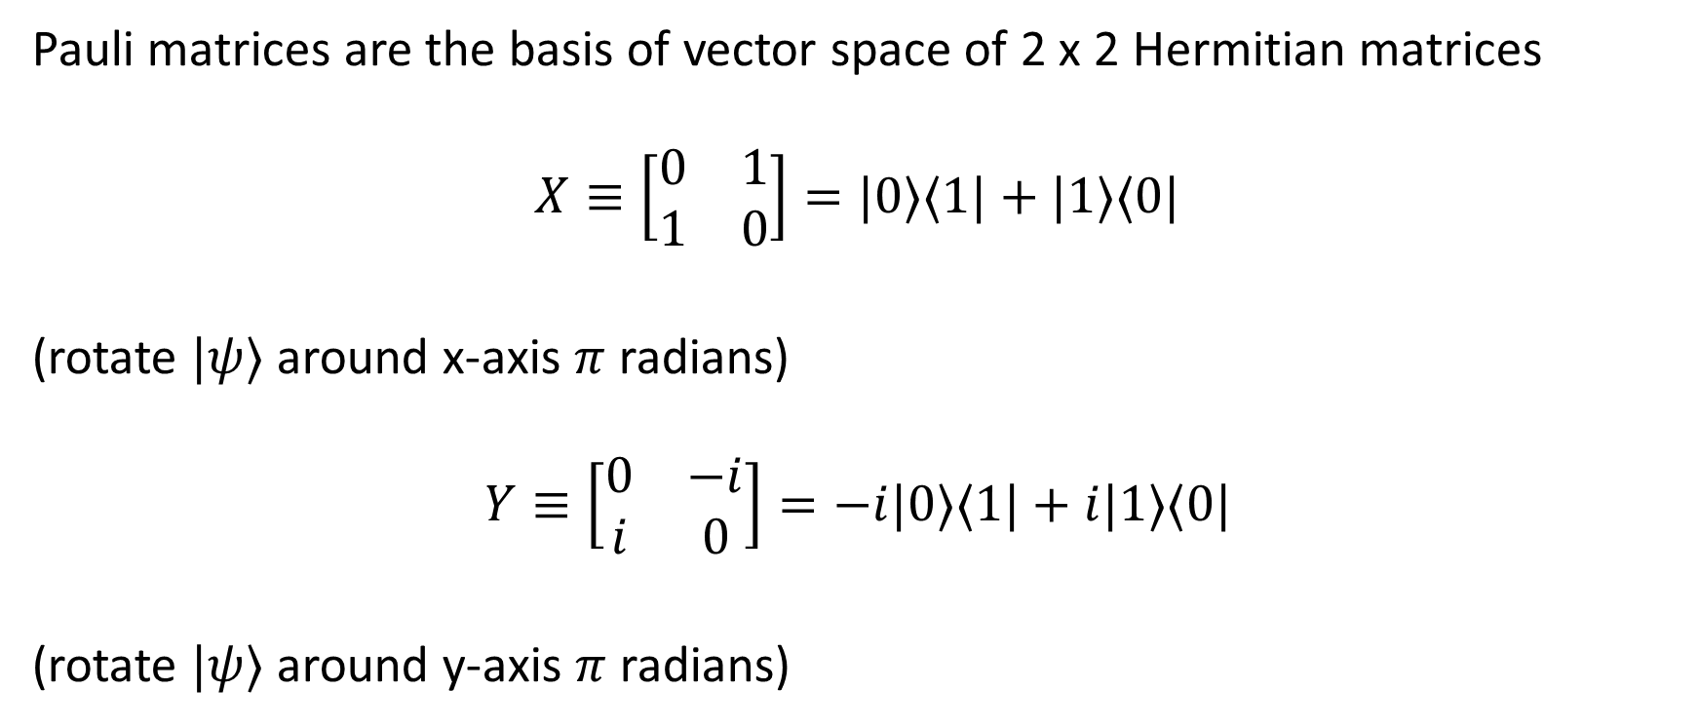
4.2. Single qubit operation / gate
Pauli matrices are the basis of vector space of 2 x 2 Hermitian matrices
$$X≡\left[\begin{matrix}0 & 1 \\ 1 & 0\end{matrix}\right]=|0⟩⟨1|+|1⟩⟨0|$$
(rotate $|ψ⟩$ around x-axis $π$ radians)
$$Y≡\left[\begin{matrix}0 & −i \\ i & 0\end{matrix}\right]=−i|0⟩⟨1|+i|1⟩⟨0|$$
(rotate $|ψ⟩$ around y-axis $π$ radians)

Slide 3

4.2. Single qubit operation / gate
$$Z≡\left[\begin{matrix}1 & 0 \\ 0 & −1\end{matrix}\right]=|0⟩⟨0|−|1⟩⟨1|$$
(rotate $|ψ⟩$ around z-axis $π$ radians)
$$I≡\left[\begin{matrix}1 & 0 \\ 0 & 1\end{matrix}\right]=|0⟩⟨0|+|1⟩⟨1|$$
Rewrite:
$$P≡\{σ_{X},σ_{Y},σ_{Z},I\}$$

Slide 4

4.2. Single qubit operation / gate
Hadamard gate
$$H=\left[\begin{matrix}1 & 1 \\ 1 & −1\end{matrix}\right]$$

Slide 5
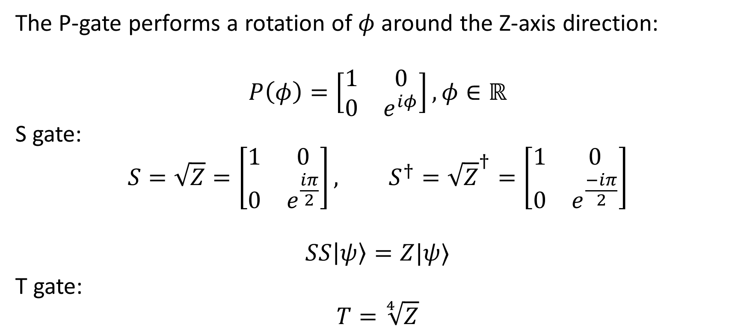
4.2. Single qubit operation / gate
The P-gate performs a rotation of $φ$ around the Z-axis direction:
$$P\left(φ\right)=\left[\begin{matrix}1 & 0 \\ 0 & e^{iφ}\end{matrix}\right],φ∈ℝ$$
S gate:
$$S=\sqrt{Z}=\left[\begin{matrix}1 & 0 \\ 0 & e^{\frac{iπ}{2}}\end{matrix}\right], S^{†}={\sqrt{Z}}^{†}=\left[\begin{matrix}1 & 0 \\ 0 & e^{\frac{−iπ}{2}}\end{matrix}\right]$$
$$SS\left|ψ\right\rangle =Z|ψ⟩$$
T gate:
$$T=\sqrt[4]{Z}$$

Slide 6
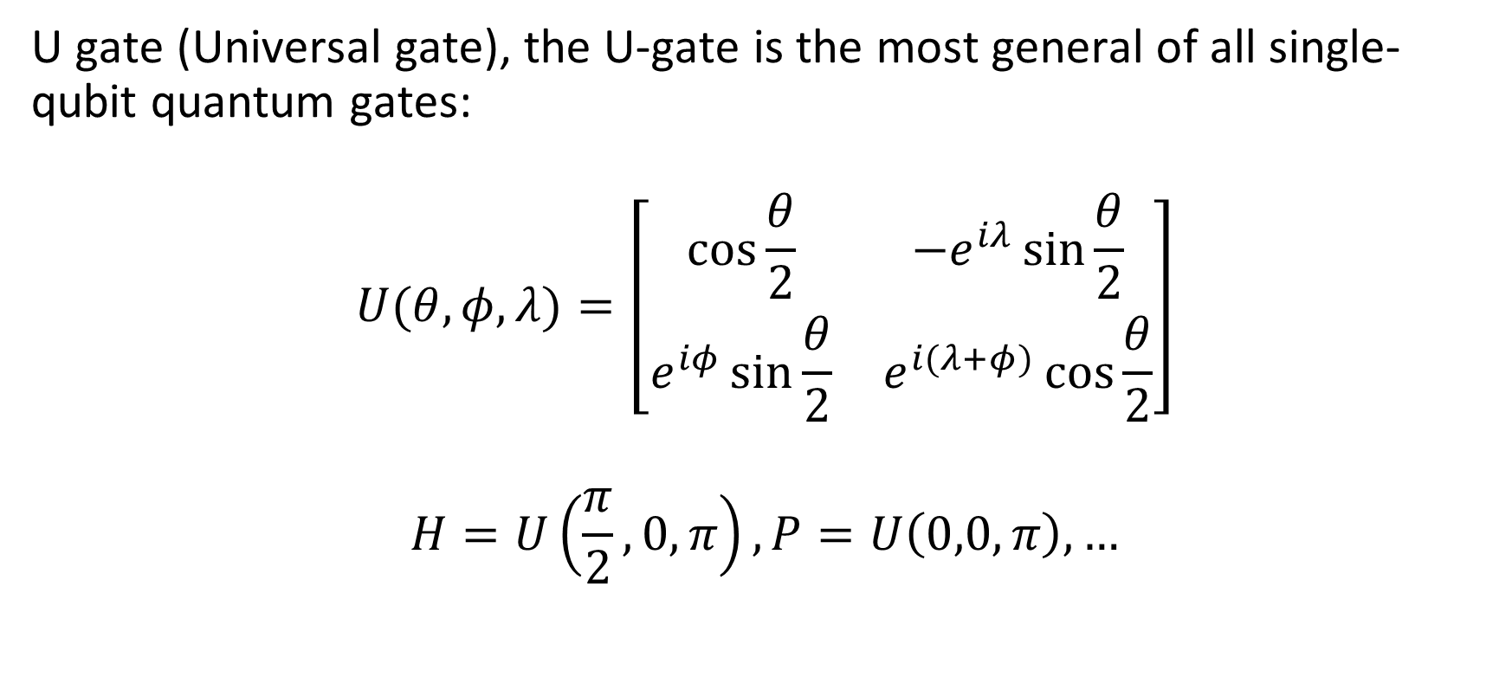
4.2. Single qubit operation / gate
U gate (Universal gate), the U-gate is the most general of all single-qubit quantum gates:
$$U(θ,φ,λ)=\left[\begin{matrix}cos⁡\frac{θ}{2} & {−e}^{iλ}\sin{\frac{θ}{2}} \\ e^{iφ}\sin{\frac{θ}{2}} & e^{i(λ+φ)}\cos{\frac{θ}{2}}\end{matrix}\right]$$
$$H=U\left(\frac{π}{2},0,π\right),P=U\left(0,0,π\right),…$$

Slide 7
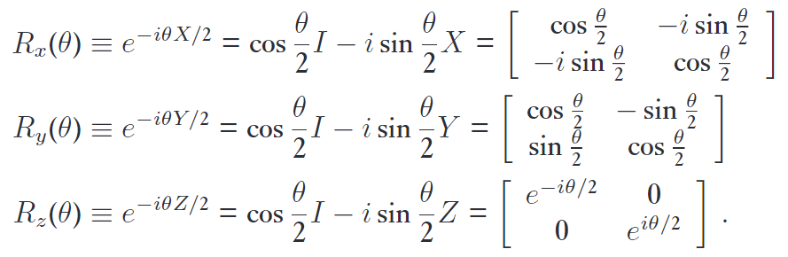

4.2. Single qubit operation / gate
Rotation gates:
Excercise 4.2.2: Let $x∈ℝ,$ and matrix $A$ such that $A^{2}=I$. Show that:
$$e^{ixA}=\cos{x}I+i\sin{x}A$$

Slide 8
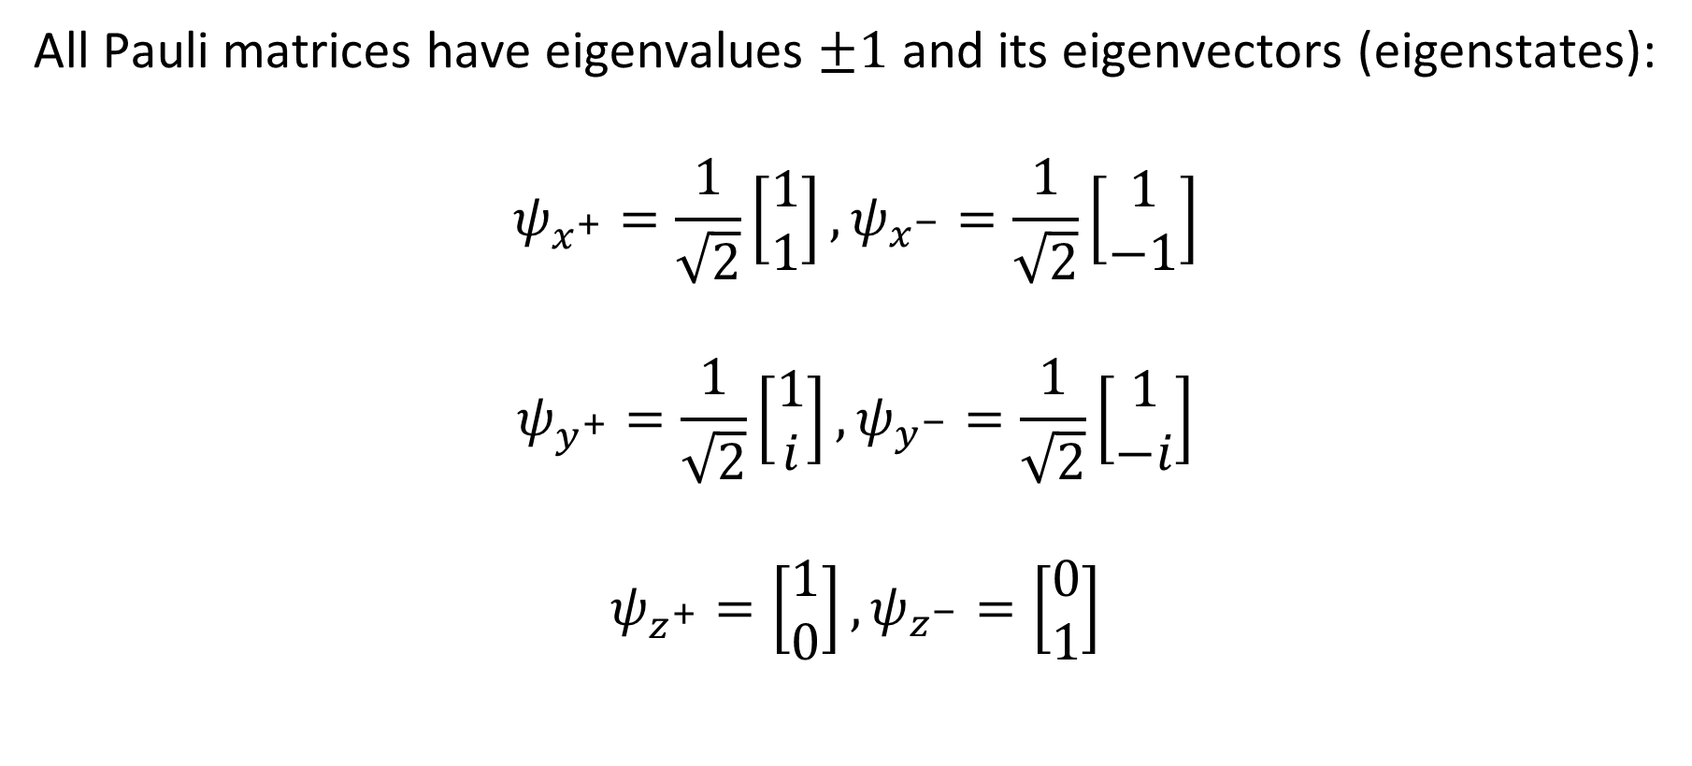
3.1. Pauli gates
All Pauli matrices have eigenvalues $±1$ and its eigenvectors (eigenstates):
$$ψ_{x^{+}}=\frac{1}{\sqrt{2}}\left[\begin{matrix}1 \\ 1\end{matrix}\right],ψ_{x^{−}}=\frac{1}{\sqrt{2}}\left[\begin{matrix}1 \\ −1\end{matrix}\right]$$
$$ψ_{y^{+}}=\frac{1}{\sqrt{2}}\left[\begin{matrix}1 \\ i\end{matrix}\right],ψ_{y^{−}}=\frac{1}{\sqrt{2}}\left[\begin{matrix}1 \\ −i\end{matrix}\right]$$
$$ψ_{z^{+}}=\left[\begin{matrix}1 \\ 0\end{matrix}\right],ψ_{z^{−}}=\left[\begin{matrix}0 \\ 1\end{matrix}\right]$$

Slide 9
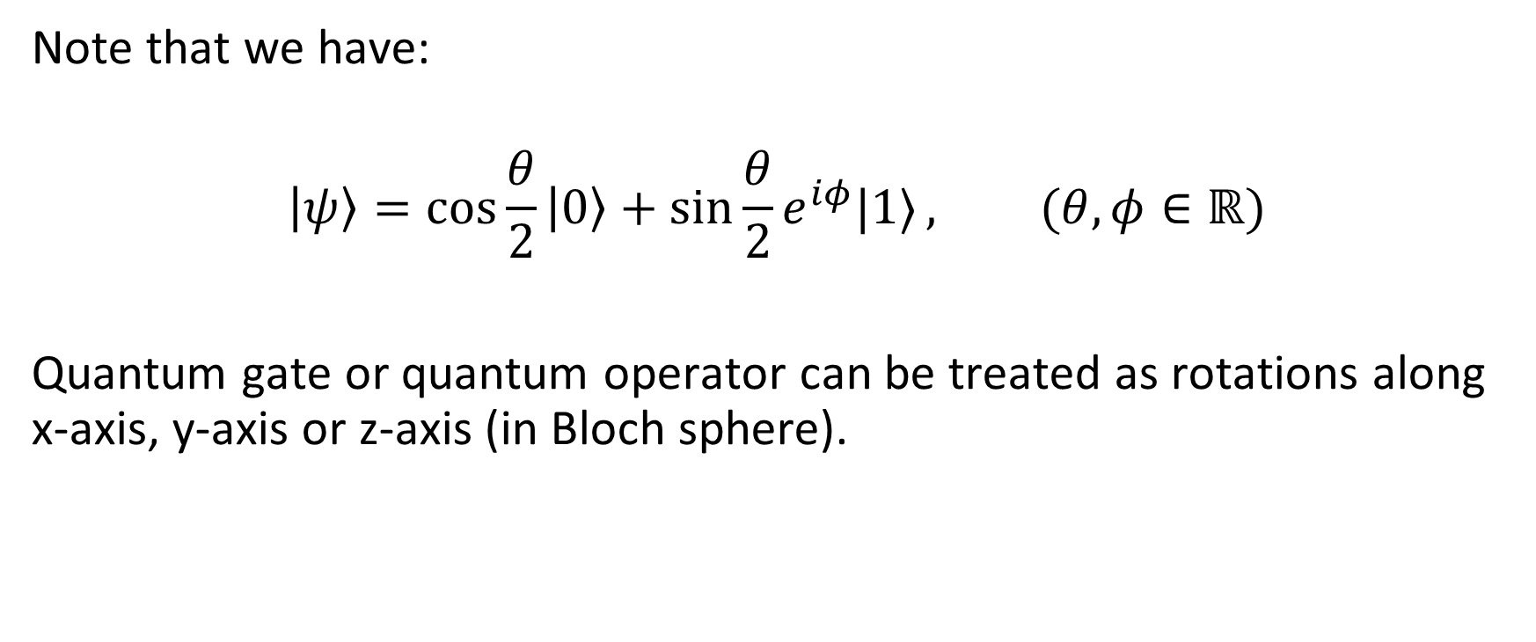
3. Multi-qubit gate
Note that we have:
$$\left|ψ\right\rangle =\cos{\frac{θ}{2}\left|0\right\rangle +\sin{\frac{θ}{2}}e^{iφ}|1⟩}, (θ,φ∈ℝ)$$
Quantum gate or quantum operator can be treated as rotations along x-axis, y-axis or z-axis (in Bloch sphere).

Slide 10

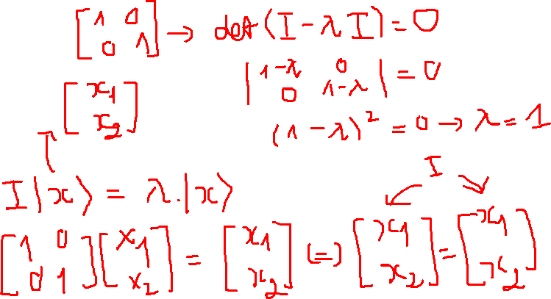
3.1. Pauli gate
What are eigenstates of Identity matrix ($0^{th}$ Pauli matrix)?

Slide 11
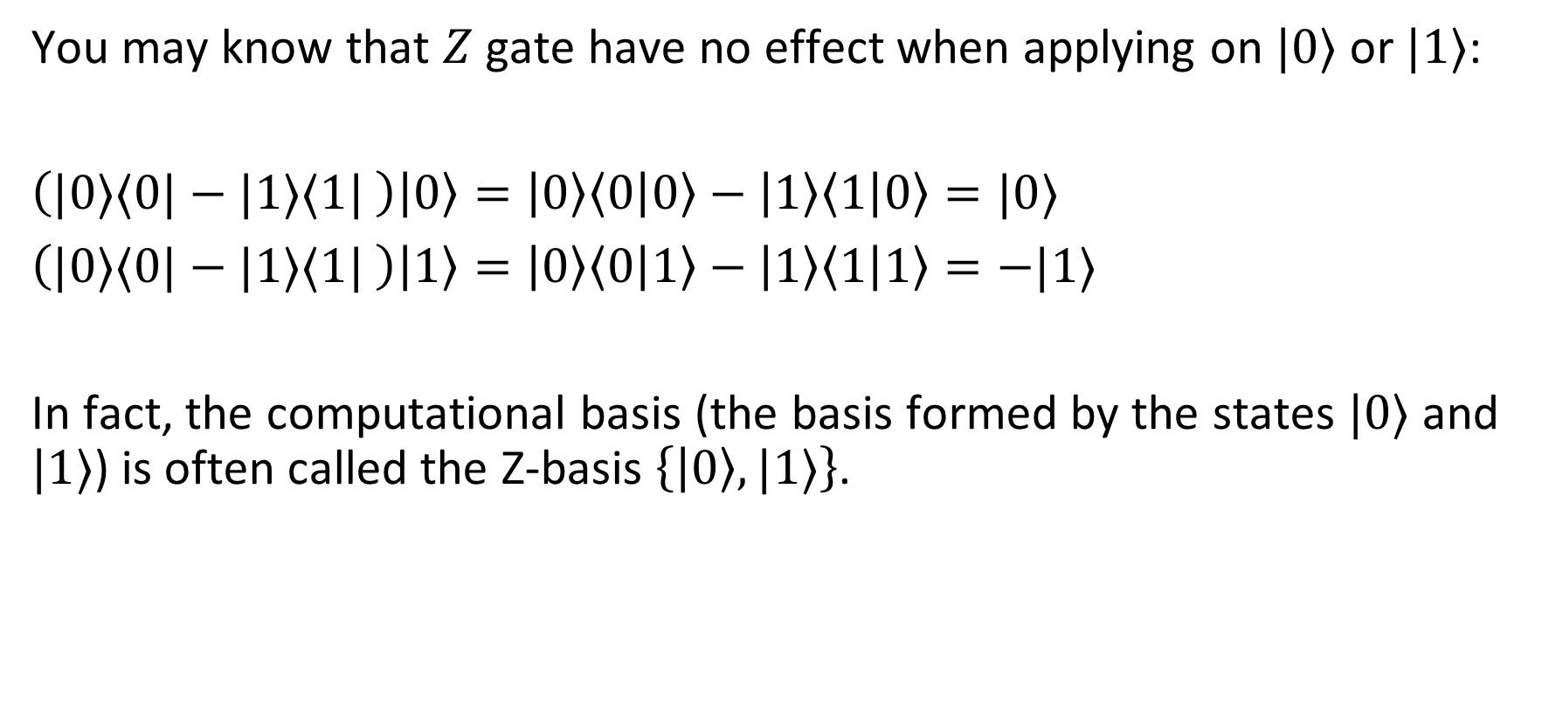
3.2. Basis
You may know that $Z$ gate have no effect when applying on $|0⟩$ or $|1⟩$:
$\left(|0⟩⟨0|−|1⟩⟨1| \right)\left|0\right\rangle =\left|0\right\rangle \left\langle 0 | 0\right\rangle −\left|1\right\rangle \left\langle 1 | 0\right\rangle =|0⟩$
$\left(|0⟩⟨0|−|1⟩⟨1| \right)\left|1\right\rangle =\left|0\right\rangle \left\langle 0 | 1\right\rangle −\left|1\right\rangle \left\langle 1 | 1\right\rangle =−|1⟩$
In fact, the computational basis (the basis formed by the states $|0⟩$ and $|1⟩$) is often called the Z-basis $\left\{\left|0\right\rangle ,|1⟩\right\}$.

Slide 12
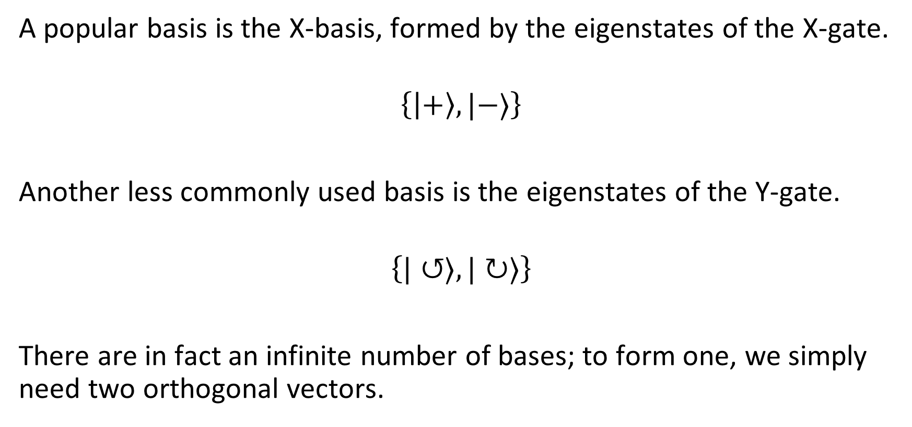
3.2. Basis
A popular basis is the X-basis, formed by the eigenstates of the X-gate.
$$\left\{\left|+\right\rangle ,|−⟩\right\}$$
Another less commonly used basis is the eigenstates of the Y-gate.
$$\left\{|↺⟩,|↻⟩\right\}$$
There are in fact an infinite number of bases; to form one, we simply need two orthogonal vectors.

Slide 13
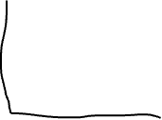

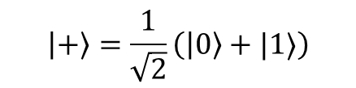
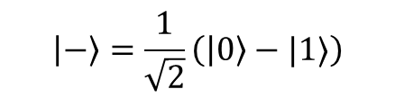










3.2. Basis
$$\left|−\right\rangle =\frac{1}{\sqrt{2}}\left(\left|0\right\rangle −|1⟩\right)$$
Visualize:
$$|1⟩$$
$${\left|β\right|}^{2}$$
$$|ψ⟩$$
$${\left|β\right|}^{2}$$
$$|ψ⟩$$
$${\left|α\right|}^{2}$$
$${\left|α\right|}^{2}$$
X-basis
$$\left|+\right\rangle =\frac{1}{\sqrt{2}}\left(\left|0\right\rangle +|1⟩\right)$$
Z-basis
$$|0⟩$$

Slide 14
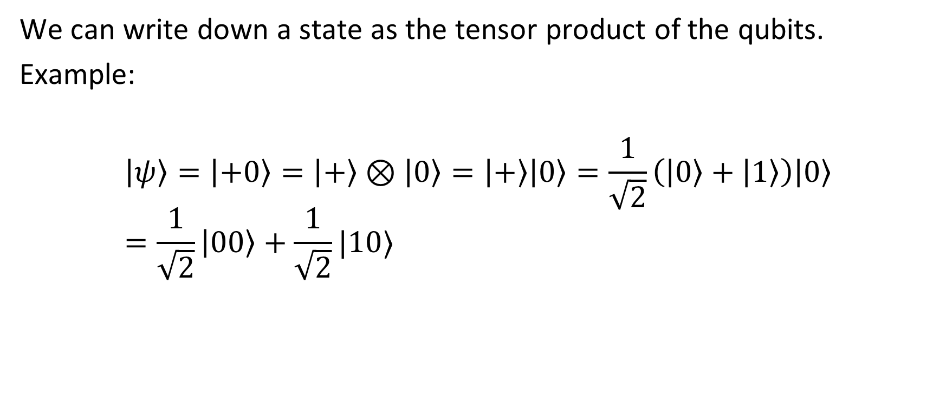
4. Entangled states
We can write down a state as the tensor product of the qubits.
Example:
$$\left|ψ\right\rangle =\left|+0\right\rangle =\left|+\right\rangle ⊗\left|0\right\rangle =\left|+\right\rangle \left|0\right\rangle =\frac{1}{\sqrt{2}}\left(\left|0\right\rangle +\left|1\right\rangle \right)\left|0\right\rangle =\frac{1}{\sqrt{2}}\left|00\right\rangle +\frac{1}{\sqrt{2}}|10⟩$$

Slide 15
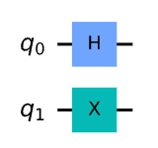
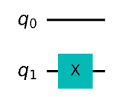

4.1. Circuit
$\left|ψ\right\rangle =H\left|q_{0}\right\rangle ⊗X|q_{1}⟩$
$=\left(H⊗X\right)\left|q_{0}q_{1}\right\rangle =\frac{1}{\sqrt{2}}\left[\begin{matrix}\begin{matrix}0 & 1 \\ 1 & 0\end{matrix} & \begin{matrix}0 & 1 \\ 1 & 0\end{matrix} \\ \begin{matrix}0 & 1 \\ 1 & 0\end{matrix} & \begin{matrix}0 & −1 \\ −1 & 0\end{matrix}\end{matrix}\right]…$
$\left|ψ\right\rangle =I\left|q_{0}\right\rangle ⊗X|q_{1}⟩$

Slide 16
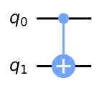

4.1. Circuit
$\left|ψ\right\rangle =CNOT|q_{0}q_{1}⟩$
$=\left[\begin{matrix}\begin{matrix}1 & 0 \\ 0 & 1\end{matrix} & \begin{matrix}0 & 0 \\ 0 & 0\end{matrix} \\ \begin{matrix}0 & 0 \\ 0 & 0\end{matrix} & \begin{matrix}0 & 1 \\ 1 & 0\end{matrix}\end{matrix}\right]…$

Slide 17
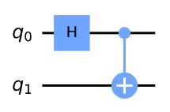
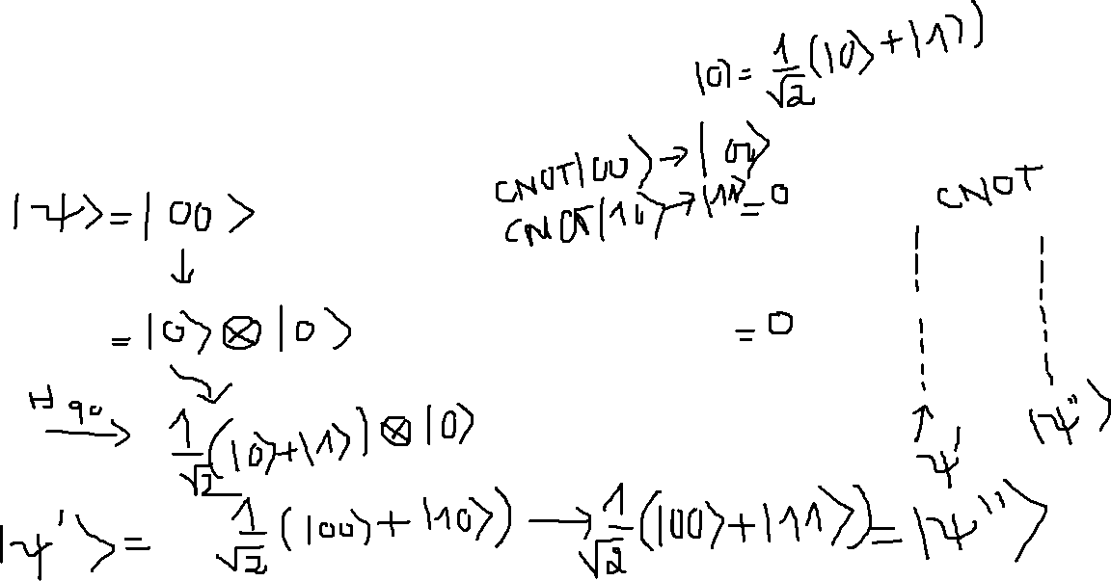
4.1. Circuit
What the output of this circuit?

Slide 18
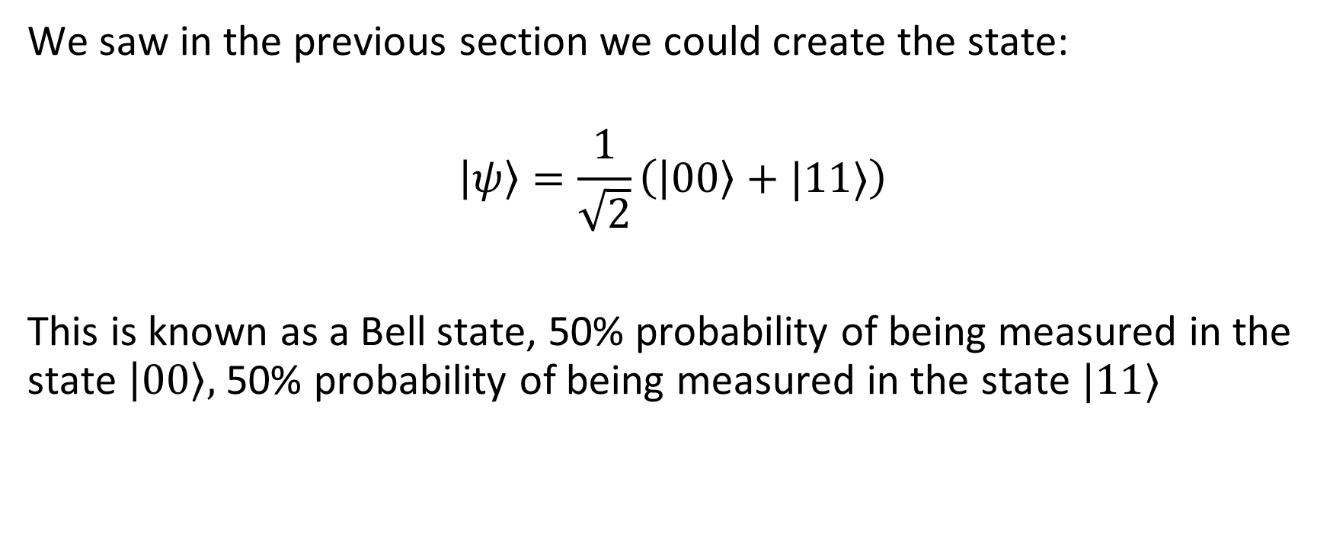
4.2. Entangled States
We saw in the previous section we could create the state:
$$\left|ψ\right\rangle =\frac{1}{\sqrt{2}}\left(\left|00\right\rangle +|11⟩\right)$$
This is known as a Bell state, 50% probability of being measured in the state $\left|00\right\rangle ,$ 50% probability of being measured in the state $|11⟩$

Slide 19
4.2. Entangled state
If we measured the first qubit, what are the value of the second qubit?
It’s also called as “spooky action at a distance” or EPR paradox.

